Slide 1
Sensor Shield Testing Procedure
05 August 2016
ROHM USDC Applications Engineering Team

Slide 2
HW/FW Preparation
For Testing the shield boards, we will use the nRF51-DK to test the board’s functionality
Prepare the board by loading the firmware for the Tester that can be found in the GitHub Repo at the following link:
https://github.com/ROHMUSDC/ROHM_SensorPlatform_Multi-Sensor-Shield
…\ROHM_SensorPlatform_Multi-Sensor-Shield\Platform Code\ShieldTesterCode_nRF51-DK
Prepare an Android or iPhone with the nRF51-DK UART APP.
nRF UART v2.0

Slide 3
Perform the Test
Connect the shield under test to the nRF51-DK board
Turn on the DK board
Connect the Phone to the DK Board named “SHLDTEST”
Check the environment around the shield
Needs any ambient light source shining onto it
Minimize Magnetic Interference as much as possible
Upon Connection, send the character “a” to start the test

Slide 4
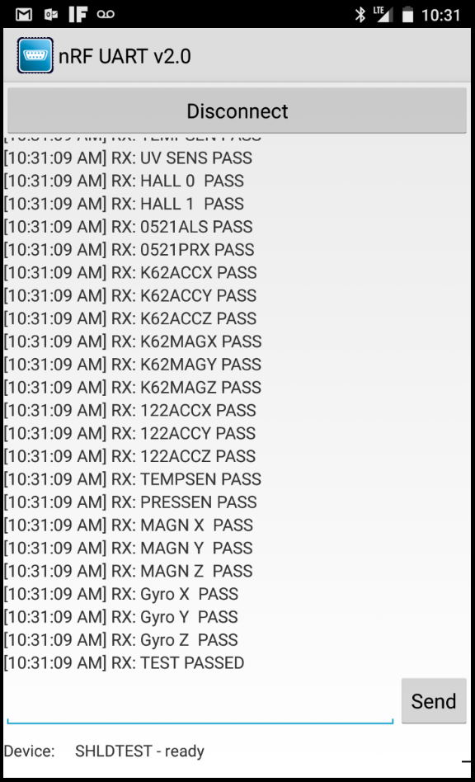
Passing Conditions
If all test pass, there is will a message at the end of the testing noting that “TEST PASSED”
If the shield passes this criteria, then we can deem the shield as OK and ship out to the WH for distribution

Slide 5
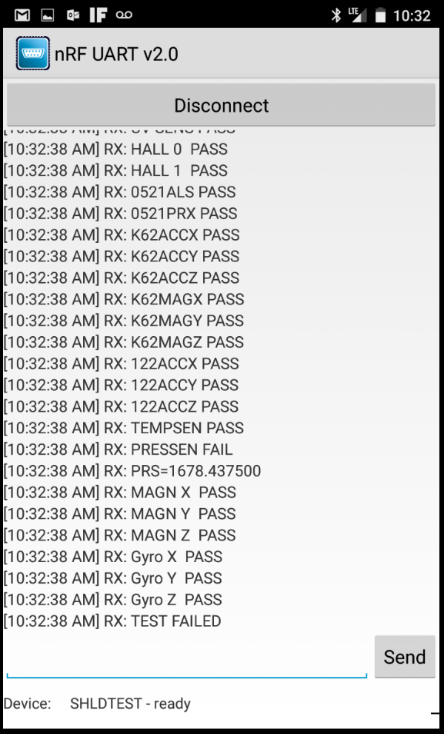
Failing Conditions
If the Test fails any of the sensor conditions, then the test will return “FAIL” and also return the value that failed the Test
Write this value down on a sticky note and keep it on the board before bagging it. These boards will be kept locally to replace sensors or used for opportunities where the broken sensors are not needed

